Slide 1
Capital Edge Analytics Data Pipeline
WAETSI Anyanwu
Notes:
Image source: AI-generated

Slide 2
Built an automated financial data pipeline
Extracts, transforms, and loads stock data
Implements incremental loading
Improves efficiency and data accuracy
Project Overview
• Understanding Automated Pipelines
• Planning and Designing the Pipeline
• Implementation Steps and Integration
• Monitoring, Maintenance, and Optimization
Notes:
Understanding Automated Pipelines Planning and Designing the Pipeline Implementation Steps and Integration Monitoring, Maintenance, and Optimization Image source: AI-generated

Slide 3
The Problem
Notes:
Definition and Key Concepts of Automation, Types of Pipelines: Data, CI/CD, Workflow, Benefits and Challenges of Automation

Slide 4
Data was manually pulled
→ slow + error-prone
Bulk loading caused duplicate data
No structured pipeline
→ inconsistent outputs
Notes:
Automation in pipelines involves the use of software tools and scripts to perform repetitive tasks without human intervention. Key concepts include orchestration, which coordinates multiple automated tasks; idempotency, ensuring tasks produce the same results if repeated; and event-driven triggers that initiate workflows based on specific inputs or conditions. Automation enhances reliability and efficiency by minimizing manual errors and accelerating processes. Image source: AI-generated

Slide 5
Project Aim
Automate data extraction from API
Transform raw data into structured format
Improve efficiency and scalability
Implement incremental loading
Notes:
Automated pipelines come in various types including Data Pipelines that orchestrate data extraction, transformation, and loading (ETL) processes; CI/CD Pipelines that automate software build, test, and deployment cycles; and Workflow Pipelines which manage broader business or operational processes through defined sequential steps. Each type addresses different objectives but shares principles of automation to improve speed, accuracy, and consistency. Image source: AI-generated

Slide 6
Architecture
API → Raw Data → Transform → Processed Data → Incremental Update
API → extraction
Raw layer → JSON storage
Transform → Data Frame
Processed → CSV
Incremental → update only new records
Notes:
The benefits of automation include increased process efficiency, reduction in manual errors, faster delivery times, and improved scalability. However, challenges encompass initial implementation cost, complexity of integration with legacy systems, need for continuous monitoring, and potential over-automation risks leading to reduced flexibility. Recognizing these factors is crucial for successful pipeline deployment. Image source: AI-generated

Slide 7
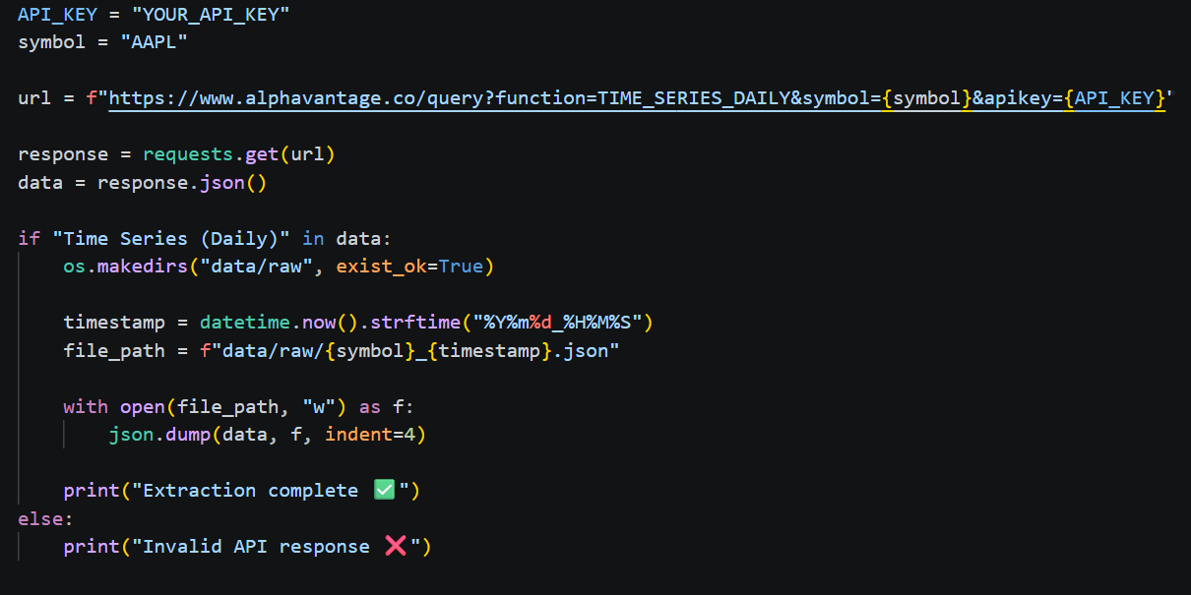
Data Extraction

Slide 8
Used Alpha Vantage API
Extracted stock data in JSON format
Automated extraction process

Slide 9
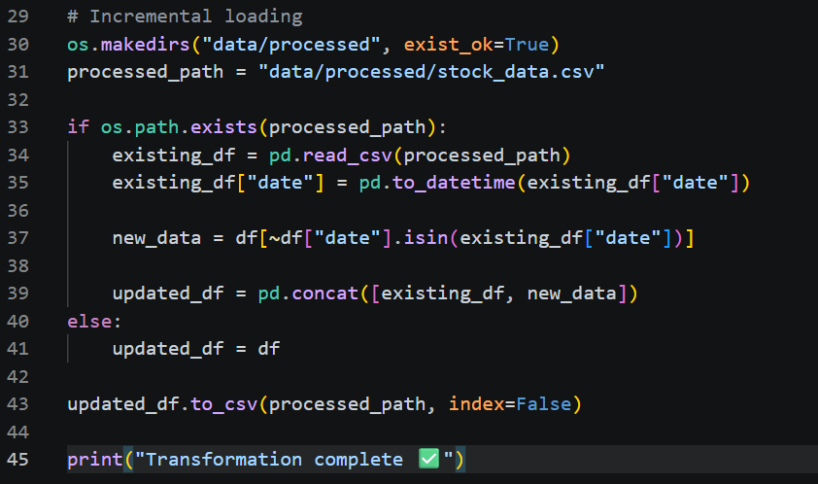
Data Transformation
Data Transformation

Slide 10
Converted JSON → DataFrame
Cleaned data types
Structured dataset for analysis

Slide 11
System checks existing dataset
Compares based on date
Adds only new records
Prevents duplication
⭐ INCREMENTAL LOADING (MOST IMPORTANT SLIDE)

Slide 12
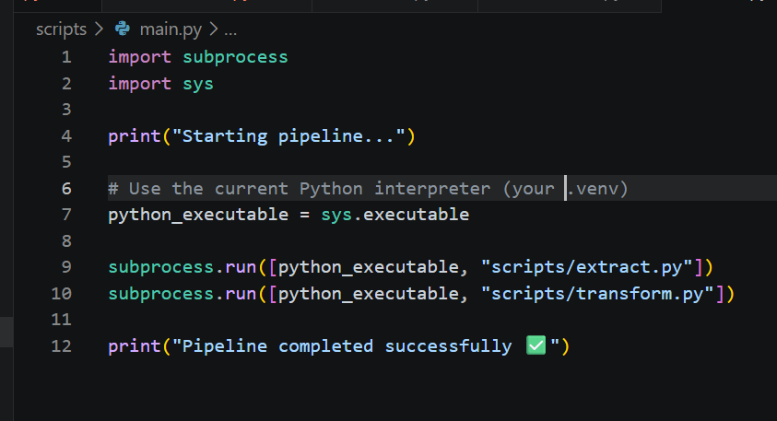
Automation

Slide 13
Automated pipeline execution
Runs extraction + transformation
Simulates orchestration (Airflow concept)

Slide 14
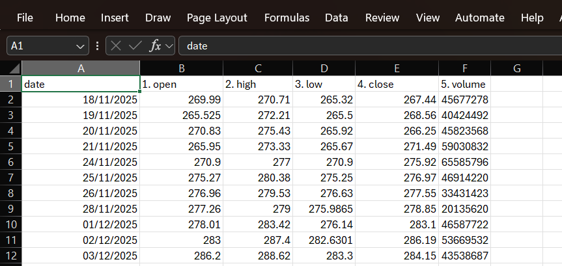
Output

Slide 15
Business Value
Reduced manual work
Improved data accuracy
Faster decision-making
Scalable solution

Slide 16
Challenges
Handling data types
Managing incremental logic
Debugging pipeline errors

Slide 17
Conclusion
Built end-to-end pipeline
Implemented efficient data processing
Ready for real-world scaling

